Slide 1


HTML
The past, the present, the future
Trần Anh Tuấn A
tuantran261083@gmail.com
Edit slide from Telerik Software Academy

Slide 2
Table of Contents (1)
Introduction to HTML
What is a Web Page?
My First HTML Page
Basic Tags: Hyperlinks, Images, Formatting
Headings and Paragraphs
HTML in Details
The <!DOCTYPE> Declaration
The <head> Section: Title, Meta, Script, Style

Slide 3
Table of Contents (2)
The <body> Section
Text Styling and Formatting Tags
Hyperlinks: <a>
Hyperlinks and Sections
Images: <img>
Lists: <ol>, <ul> and <dl>
HTML Special Characters
The <div> and <span> elements

Slide 4
Table of Contents(3)
Introducing to HTML5
Changed old tags
New tags
New Attributes
New Structural Tags

Slide 5



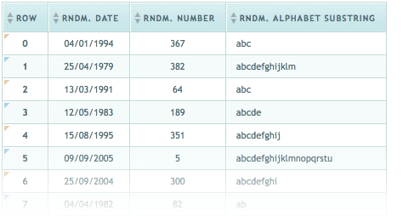
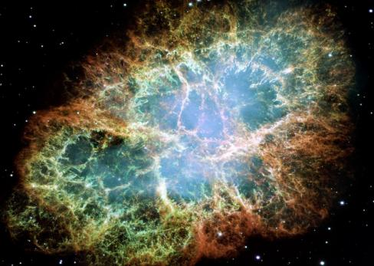
Introduction to HTML
Web 101

Slide 6
What is HTML
HTML was designed to be simple language for describing documents
It was created by scientists, so “simple” is not always your average “simple”
Describing means outlining the structure of a document in terms of parts: headings, paragraphs, lists, tables etc.
To start coding HTML, just create a new file with “.html” extension, our touch it
Think in structure, not presentation

Slide 7
HTML Structure
HTML was inspired by other similar languages, such as GML and Scribe
HTML1 had tags for the following elements:
Paragraphs, Headings, Anchors (links), Horizontal rule, Line breaks though they proved insufficient and later more were added
What are tags?
A tag is the red letter from above enclosed in angle brackets: <p> is for paragraph
A pair of starting and end tag forms an element

Slide 8
Simple Q&A
Q: Why Anchor and not Link?
A: As mentioned earlier, HTML was created by scientists and they tend to have different opinion than we do
Btw, there is Link in HTML, it just does another job
Q: So I just write opening and closed tags?
A: Mostly. There are exceptions.
And you haven’t asked about nesting

Slide 9
Nesting
Nesting is when you want to put a tag in a tag
You’ve seen “Inception”, you know what I mean
And like in “Inception”, the more you nest, the nastier it gets
Not all tags can be put in all tags
Like, if you want to make an entire paragraph to be a link, you don’t put the link around the paragraph, but vice versa
Scientists, go figure

Slide 10
HTML Code Formatting
The HTML source code should be formatted to increase readability and facilitate debugging.
Every block element should start on a new line.
Every nested (block) element should be indented.
Browsers ignore multiple whitespaces in the page source, so formatting is harmless.
For performance reasons, formatting can be sacrificed

Slide 11
What happened next?
HTML evolved driven by people and browsers
New versions of HTML
Inevitably a doctype
Accompanying technologies
CSS, JavaScript
Plugins like Java, Flash, Silverlight
Rich media and so on…

Slide 12
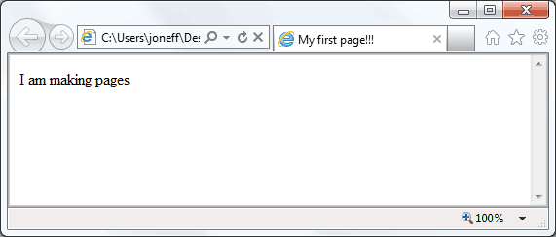
My first web page
first-page.html
Boring
<html>
<head>
<title>My first page!!!</title>
</head>
<body>
<p>I am making pages</p>
</body>
</html>
Content
Boring

Slide 13
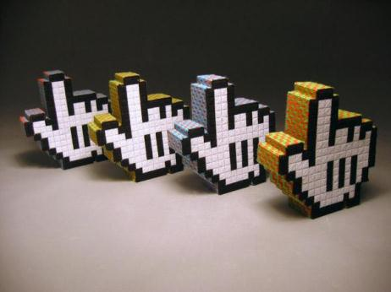

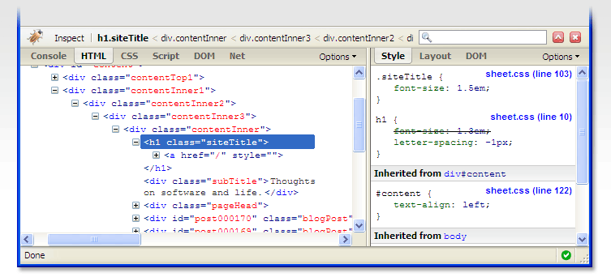

HTML Basics
Time to get dirty

Slide 14
Some Simple Tags
Hyperlink Tags
Image Tags
Text formatting tags
<a href="http://www.telerik.com/"
title="Telerik">Link to Telerik Web site</a>
<img src="logo.gif" alt="logo" width="50" />
This text is <em>emphasized.</em>
<br />new line<br />
This one is <strong>more emphasized.</strong>

Slide 15
Simple Q&A
Q: What are the equation looking things?
A: That would be attributes
Attributes add more information to an element
Let’s examine:
So my src attribute equals (is) logo.gif
My alt attribute is logo
You can tell it’s 50 pixels wide
<img src="logo.gif" alt="logo" widht="50" />

Slide 16
Attributes
Some attributes can apply to all element:
id, style, class, title
The id is unique in the document
The title attribute is displayed as hint when the element is hovered with the mouse
Some attributes are optional
Some are mandatory
Some elements MUST have attributes
the image element must have a src attribute

Slide 17
Remember
It is important to have the correct vision and attitude towards HTML
HTML is only about structure, not appearance
Browsers tolerate invalid HTML code and parse errors – you should not
Always think about semantics

Slide 18
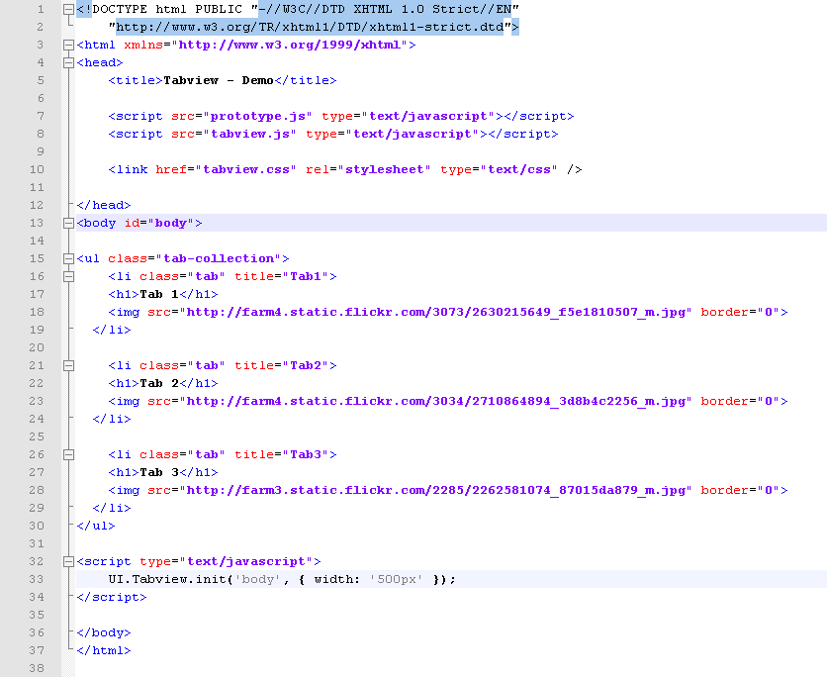
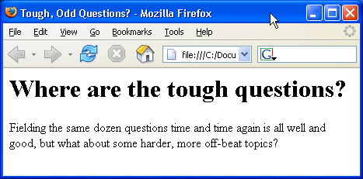
Common Tags
The ones needed 80% of the time

Slide 19
Hyperlinks
Hyperlinks, or just links, are one-way tie between two documents
Put simply, if you have a page, and you want to go to another page, you click (follow) a link
A link must have a destination (href) attribute and text content
Href means “hypertext reference”
Optionally, it my have a title
<a href="a.html" title=“Go to A">Click</a>

Slide 20
Hyperlinks (2)
Link to a document on the same server in the same directory:
Link to a document on the same server in the parent directory:
Link to a document on the same server in the sub directory stuff:
<a href="form.html">Fill Our Form</a>
<a href="../parent.html">Parent</a>
<a href="stuff/cat.html">Catalog</a>

Slide 21
Hyperlinks (3)
Link to a document on the same server in the root (top most) directory:
Remember:
if not linking to the root (/), links are relative to the current document and may be broken if you move the origin document
You can do any number of going up (../), but you can’t go upper than the root
<a href=“/form.html">Fill Our Form</a>

Slide 22
Hyperlinks (4)
Link to an external web site:
Always use the full URL, including the protocol (http://), not just “devbg.org”
Using the target attribute tells the browser where to open the link, with _blank meaning open in new window
Link to an email address:
<a href="http://devbg.org" target="_blank">BASD</a>
<a href="mailto:bugs@example.com?subject=Bug+Report">
Please report bugs here (by e-mail only)</a>

Slide 23
Hyperlinks and Sections
Link to another location in the same document:
Link to a specific location in another document:
<a href="#section1">Go to Introduction</a>
...
<h2 id="section1">Introduction</h2>
<a href="chapter3.html#section3.1.1">Go to Section 3.1.1</a>
<!–- In chapter3.html -->
...
<div id="section3.1.1">
<h3>3.1.1. Technical Background</h3>
</div>

Slide 24
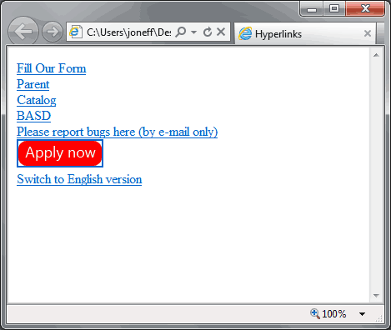
Hyperlinks – Example
hyperlinks.html
<a href="form.html">Fill Our Form</a> <br />
<a href="../parent.html">Parent</a> <br />
<a href="stuff/cat.html">Catalog</a> <br />
<a href="http://www.devbg.org" target="_blank">BASD</a> <br />
<a href="mailto:bugs@example.com?subject=Bug Report">Please report bugs here (by e-mail only)</a>
<br />
<a href="apply-now.html"><img src="apply-now.png" /></a> <br />
<a href="../english/index.html">Switch to English version</a> <br />

Slide 25
Links to the Same Document – Example
hyperlinks-sections.html
<h1>Table of Contents</h1>
<p><a href="#section1">Introduction</a><br />
<a href="#section2">Some background</A><br />
<a href="#section2.1">Project History</a><br />
...the rest of the table of contents...
<!-- The document text follows here -->
<h2 id="section1">Introduction</h2>
... Section 1 follows here ...
<h2 id="section2">Some background</h2>
... Section 2 follows here ...
<h3 id="section2.1">Project History</h3>
... Section 2.1 follows here ...

Slide 26
Images: <img> tag
Inserting an image with <img> tag:
Image attributes:
Example:
<img src="/img/basd-logo.png“ />
src | Location of image file (relative or absolute)
alt | Substitute text for display (e.g. in text mode)
height | Number of pixels of the height
width | Number of pixels of the width
border | Size of border, 0 for no border
<img src="php.png" alt="PHP Logo" />
26

Slide 27
Headings and Paragraphs
Heading Tags (h1 – h6)
Paragraph Tags
Sections: div and span
<h1>Heading 1</h1>
<h2>Sub heading 2</h2>
<h3>Sub heading 3</h3>
<p>This is my first paragraph</p>
<p>This is my second paragraph</p>
<div>This is a div</div>
<span>This is a div</span>

Slide 28
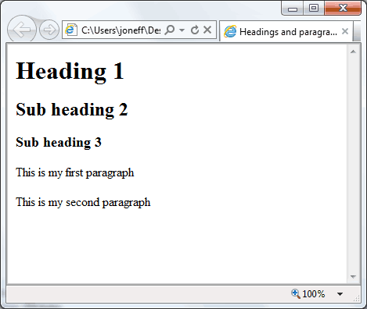
Headings and Paragraphs – Example
headings-and-paragraphs.html
<html>
<head><title>Headings and paragraphs</title></head>
<body>
<h1>Heading 1</h1>
<h2>Sub heading 2</h2>
<h3>Sub heading 3</h3>
<p>This is my first paragraph</p>
<p>This is my second paragraph</p>
</body>
</html>

Slide 29
Text Formatting
Text formatting tags modify the text between the opening tag and the closing tag
Ex. <b>Hello</b> makes “Hello” bold
<b></b> | bold
<i></i> | italicized
<u></u> | underlined
<sup></sup> | Sample^{superscript}
<sub></sub> | Sample_{subscript}
<strong></strong> | strong
<em></em> | emphasized
<pre></pre> | Preformatted text
<blockquote></blockquote> | Quoted text block
<del></del> | Deleted text – strike through
29

Slide 30
Simple Q&A
Q: Bold or strong?
A: Strong
Bold describes the looks e.g. the font is bold, strong describes the importance e.g. this word is emphasized on with great importance
Q: So I suppose it’s emphasized and not italics?
A: Correct
Bold, italics, underline are deprecated and will talk about that in a moment

Slide 31
More on formatting
Thinks semantics:
Emphasize, Strong emphasize, Insertion, Deletion, Sub-script, Super-script, Quotations
Those describe parts of the document
There are other, lesser known text formatting elements for input, output, variables and other parts of a document, say a tech spec, but if you come to need those, you can easily google
As usual, most of them are for scientific / engineering purposes and might look weird

Slide 32
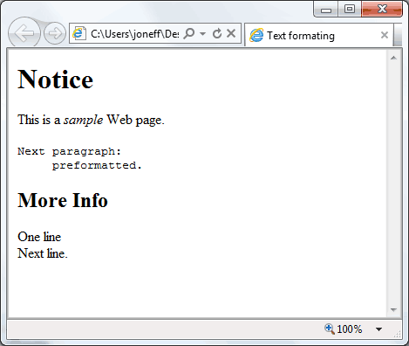
Text Formatting – Example
text-formatting.html
<html>
<head>
<title>Text formating</title>
</head>
<body>
<h1>Notice</h1>
<p>This is a <em>sample</em> Web page.</p>
<p><pre>Next paragraph:
preformatted.</pre></p>
<h2>More Info</h2>
<p>One line<br />
Next line.</p>
</body>
</html>

Slide 33
Ordered Lists
Create an Ordered List using <ol></ol>:
Attribute values for type are 1, A, a, I, or i
<ol type="1">
<li>Apple</li>
<li>Orange</li>
<li>Grapefruit</li>
</ol>
Apple
Orange
Grapefruit
Apple
Orange
Grapefruit
Apple
Orange
Grapefruit
Apple
Orange
Grapefruit
Apple
Orange
Grapefruit

Slide 34
Unordered Lists
Create an Unordered List using <ul></ul>:
Attribute values for type are:
disc, circle or square
<ul type="disk">
<li>Apple</li>
<li>Orange</li>
<li>Grapefruit</li>
</ul>
Apple
Orange
Pear
Apple
Orange
Pear
Apple
Orange
Pear

Slide 35
Definition lists
Create definition lists using <dl>
Pairs of text and associated definition; text is in <dt> tag, definition in <dd> tag
Renders without bullets
Definition is indented
<dl>
<dt>HTML</dt>
<dd>A markup language …</dd>
<dt>CSS</dt>
<dd>Language used to …</dd>
</dl>

Slide 36
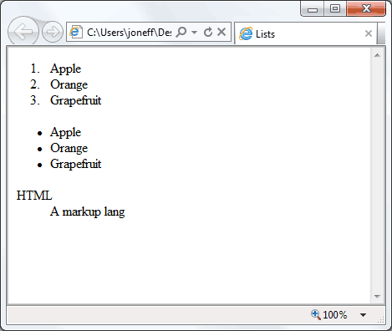
Lists – Example
lists.html
<ol type="1">
<li>Apple</li>
<li>Orange</li>
<li>Grapefruit</li>
</ol>
<ul type="disc">
<li>Apple</li>
<li>Orange</li>
<li>Grapefruit</li>
</ul>
<dl>
<dt>HTML</dt>
<dd>A markup lang…</dd>
</dl>

Slide 37
Miscellaneous Tags
<hr />: Draws a horizontal rule (line):
<center></center>: Deprecated!
<font></font>: Deprecated!
<hr size="5" width="70%" />
<center>Hello World!</center>
<font size="3" color="blue">Font3</font>
<font size="+4" color="blue">Font+4</font>

Slide 38
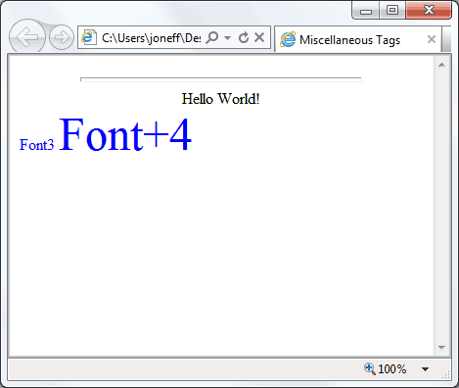
Miscellaneous Tags – Example
misc.html
<html>
<head>
<title>Miscellaneous Tags Example</title>
</head>
<body>
<hr size="5" width="70%" />
<center>Hello World!</center>
<font size="3" color="blue">Font3</font>
<font size="+4" color="blue">Font+4</font>
</body>
</html>

Slide 39
Introduction to HTML
HTML Document Structure in Depth

Slide 40

HTML Flavors
Lime, Mint and Tonic

Slide 41
HTML Versions
HTML has evolved during the years
From a handful of tags to over a hundred
Though very few tags were removed, many new were added
By design, if a tag is not recognized, it’s ignored and its text content is shown
Problem: how to tell browsers which version is used in a document?

Slide 42
The <!DOCTYPE> Declaration
HTML documents must start with a document type definition (DTD)
It tells web browsers what type is the served code
Possible versions: HTML 4.01, XHTML 1.0 (Transitional or Strict), XHTML 1.1, HTML 5
Example:
See http://w3.org/QA/2002/04/valid-dtd-list.html for a list of possible doctypes
<!DOCTYPE html PUBLIC "-//W3C//DTD XHTML 1.0 Transitional//EN" "http://www.w3.org/TR/xhtml1/DTD/xhtml1-transitional.dtd">

Slide 43

HTML vs. XHTML
XHTML is more strict than HTML
Tags and attribute names must be in lowercase
All tags must be closed (<br/>, <img/>) while HTML allows <br> and <img> and implies missing closing tags (<p>par1 <p>par2)
XHTML allows only one root <html> element (HTML allows more than one)

Slide 44
XHTML vs. HTML (2)
Many element attributes are deprecated in XHTML, most are moved to CSS
Attribute minimization is forbidden, e.g.
Note: Web browsers load XHTML faster than HTML and valid code faster than invalid!
<input type="checkbox" checked>
<input type="checkbox" checked="checked" />

Slide 45
Quick Q&A
Q: Which doctype to use?
A: XHTML 1.0 Transitional is usually OK
Do not be tempted by XHTML 1.1
Q: How to remember them?
A: Don’t. Just know which one does what and if needed google

Slide 46

Boring Stuff
Head, Body, Comments and More…

Slide 47
The <head> Section
Contains information that doesn’t show directly on the viewable page
Starts after the <!doctype> declaration
Begins with <head> and ends with </head>
Contains mandatory single <title> tag
Can contain some other tags, e.g.
<meta>
<script>
<style>
<!–- comments -->

Slide 48
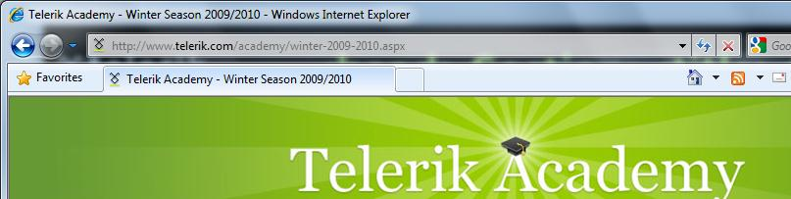
<title>
Title should be placed between <head> and </head> tags
Used to specify a title in the window titlebar
Search engines and people rely on titles
<title>Telerik Academy – Winter Season 2009/2010 </title>

Slide 49
<meta>
Meta tags additionally describe the content contained within the page
<meta name="description" content="HTML tutorial" />
<meta name="keywords" content="html, web design, styles" />
<meta name="author" content="Chris Brewer" />
<meta http-equiv="refresh" content="5; url=http://www.telerik.com" />

Slide 50
<script>
The <script> element is used to embed scripts into an HTML document
Script are executed in the client's Web browser
Scripts can live in the <head> and in the <body> sections
Supported client-side scripting languages:
JavaScript (it is not Java!) – de facto standard
VBScript (obsolete)
Jscript (obsolete)

Slide 51
<style>
The <style> element embeds formatting information (CSS styles) into an HTML page
style-example.html
<html>
<head>
<style type="text/css">
p { font-size: 12pt; line-height: 12pt; }
p:first-letter { font-size: 200%; }
span { text-transform: uppercase; }
</style>
</head>
<body>
<p>Styles demo.<br />
<span>Test uppercase</span>.
</p>
</body>
</html>

Slide 52
<!-- -->
Comments can exist anywhere between the <html></html> tags
Comments start with <!-- and end with -->
<!–- Telerik Logo (a JPG file) -->
<img src="logo.jpg" alt=“Telerik Logo">
<!–- Hyperlink to the web site -->
<a href="http://telerik.com/">Telerik</a>
<!–- Show the news table -->
<table class="newstable">
...

Slide 53
<body> Section: Introduction
The <body> section describes the viewable portion of the page
Starts after the <head> </head> section
Begins with <body> and ends with </body>
<html>
<head><title>Test page</title></head>
<body>
<!-- This is the Web page body -->
</body>
</html>

Slide 54
HTML Special Characters
Symbol Name
HTML Entity
Symbol
Copyright Sign
&copy;
©
Registered Trademark Sign
&reg;
®
Trademark Sign
&trade;
™
Less Than
&lt;
<
Greater Than
&gt;
>
Ampersand
&amp;
&
Non-breaking Space
&nbsp;
Em Dash
&mdash;
—
Quotation Mark
&quot;
"
Euro
&#8364;
€
British Pound
&pound;
£
Japanese Yen
&yen;
¥
54

Slide 55
Special Characters – Example
special-chars.html
<p>[&gt;&gt;&nbsp;&nbsp;Welcome
&nbsp;&nbsp;&lt;&lt;]</p>
<p>&#9658;I have following cards:
A&#9827;, K&#9830; and 9&#9829;.</p>
<p>&#9658;I prefer hard rock &#9835;
music &#9835;</p>
<p>&copy; 2006 by Svetlin Nakov &amp; his team</p>
<p>Telerik Academy™</p>

Slide 56
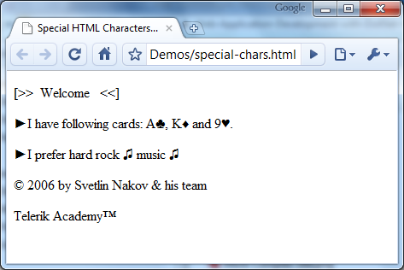
Special Chars – Example (2)
special-chars.html
<p>[&gt;&gt;&nbsp;&nbsp;Welcome
&nbsp;&nbsp;&lt;&lt;]</p>
<p>&#9658;I have following cards:
A&#9827;, K&#9830; and 9&#9829;.</p>
<p>&#9658;I prefer hard rock &#9835;
music &#9835;</p>
<p>&copy; 2006 by Svetlin Nakov &amp; his team</p>
<p>Telerik Academy™</p>

Slide 57
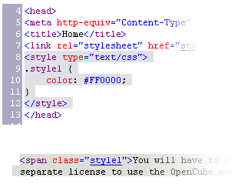

Using <DIV> and <SPAN> Block and Inline Elements

Slide 58
Block and Inline Elements
Block elements add a line break before and after them, and expand to 100% width
<div>, <p>, <h1>, <ul> are block elements
Inline elements don’t break the text before and after them
<span>, <a>, <em> are inline elements
http://www.w3.org/TR/CSS2/visuren.html#block-boxes

Slide 59
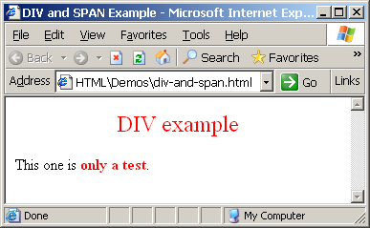
The <div> Tag
<div> creates logical divisions within a page
Block style element
Used with CSS
Example:
div-and-span.html
<div style="font-size:24px; color:red">DIV example</div>
<p>This one is <span style="color:red; font-weight:bold">only a test</span>.</p>

Slide 60
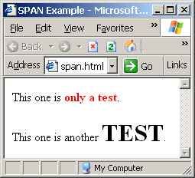
The <span> Tag
Inline style element
Useful for modifying a specific portion of text
Don't create a separate area (paragraph) in the document
Makes sense only with some CSS
span.html
<p>This one is <span style="color:red; font-weight:bold">only a test</span>.</p>
<p>This one is another <span style="font-size:32px; font-weight:bold">TEST</span>.</p>

Slide 61



HTML Tags Index
http://www.w3.org/TR/html4/index/elements.html
http://www.htmldog.com/reference/htmltags/

Slide 62






HTML 5
What the … is HTML 5?

Slide 63
What is HTML 5?
HTML5 – the next major revision of the HTML
Currently under development
Far away from final version
Developed under the HTML 5 working group of the World Wide Web Consortium (W3C) in 2007
First Public Working Draft of the specification
January 22, 2008
Parts of HTML5 are being implemented in browsers before the whole specification is ready

Slide 64

HTML – Past, Present, Future
1991 – HTML first mentioned – Tim Berners-Lee – HTML tags
1993 – HTML (first public version, published at IETF)
1993 – HTML 2 draft
1995 – HTML 2 – W3C
1995 – HTML 3 draft
1997 – HTML 3.2 – “Wilbur”
1997 – HTML 4 – ”Cougar” – CSS
1999 – HTML 4.01 (final)
2000 – XHTML draft
2001 – XHTML (final)
2008 – HTML5 / XHTML5 draft
2011 – feature complete HTML5
2022 – HTML5 – final specification

Slide 65
HTML 5 Goals
Latest version is HTML5
Aimed to have all of the power of native applications
Run on any platform (Windows, Linux, iPhone, Android, etc.)
New features should be based on HTML, CSS, DOM and JavaScript
Reduce the need for external plugins
Better error handling
More markup to replace scripting

Slide 66





Designer Outlook
What a Designer Should Know?

Slide 67
Changed Old Tags
Doctype tag:
HTML tag:
Meta tag:
Link tag:
<!DOCTYPE html>
<html lang="en" xml:lang="en">
<meta charset="utf-8">
<link rel="stylesheet" href="style-original.css">

Slide 68
New Layout Sctucture
Better layout structure: new structural elements
<section>
<header>
<nav>
<article>
<aside>
<footer>
<header>
<nav>
<section>
<aside>
<header>
<article>
<footer>
<footer>
68

Slide 69
New Layout Sctucture (2)
Elements like header and footer are not meant to be only at the top and bottom of the page
Header and footer of each document section
Not very different from <DIV> tag but are more semantically well defined in the document structure
69

Slide 70
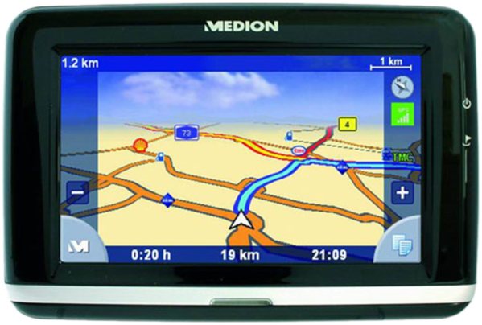
New Layout Sctucture – Example
<body>
<header>
<hgroup>
<h1>HTML 5 Presentation</h1>
<h2>New Layout Structure</h2>
</hgroup>
</header>
<nav>
<ul>
Lecture
</ul>
<ul>
Demos
</ul>
<ul>
Trainers
</ul>
</nav>
70

Slide 71
New Layout Sctucture – Example (2)
<section>
<article>
<header>
<h1>First Paragraph</h1>
</header>
<section>
Some text
</section>
</article>
</section>
<aside>
<a href="http://academy.telerik.com"> more info</a>
</aside>
<footer>
Done by Doncho Minkov, (c) 2011, Telerik Academy
</footer>
</body>
71

Slide 72
New Tags
<article>
For external content, like text from a news-article, blog, forum, or any other external source
<aside>
For content aside from (but related to) the content it is placed in
<details>
For describing details about a document, or parts of a document
<summary>
A caption, or summary, inside the details element
72

Slide 73

New Tags (2)
<mark>
For text that should be highlighted
<nav>
For a section of navigation
<section>
For a section in a document (e.g. chapters, headers, footers)
<wbr>
Word break. For defining an appropriate place to break a long word or sentence
Other tags
<command>, <datalist>, <details>, <progress>, etc.
73

Slide 74
New Media Tags
Media Tags
<audio>
Attributes: autoplay, controls, loop, src
<video>
Attributes: autoplay, controls, loop, height, width, src
<audio width="360" height="240" controls= "controls" >
<source src="someSong.mp3" type="audio/mp3">
</source>
Audio tag is not supported
</audio>
74

Slide 75
HTML - The past, the present, the future

